Slide 1
SUBASSEMBLY ACTIVITIES TO FOCUS ON 18TH MARCH - 5TH APRIL 2019

Slide 2
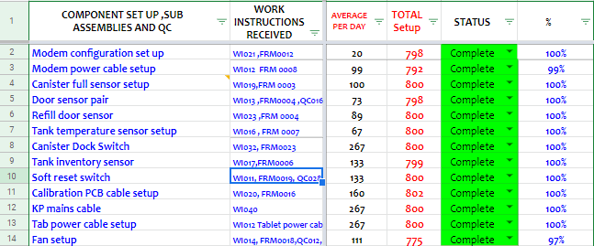
ACTIVITIES COMPLETED

Slide 3
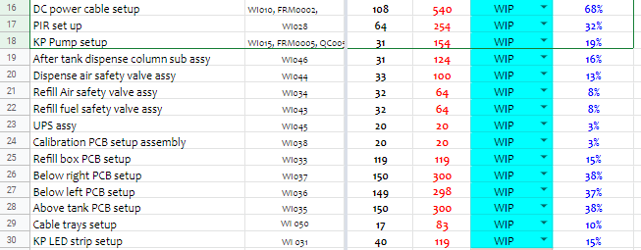
WORK IN PROGRESS ACTIVITIES

Slide 4
WORK ALLOCATION PER WORK CENTRE
Activity Per Work Centre | Mon 18 TH | Tue 19TH | Wed 20TH | Thur 21ST | Friday 22ND | Weekly TOTAL
KP Pump setup-SA2 | 32 | 32 | 32 | 32 | 32 | 160
Modem Sim card setup SA4 | 40 | 40 | 40 | 40 | 40 | 200
1.Calibration PCB assy-SA3 2.Below left PCB 2.NFC assy | 32 | 32 | 32 | 32 | 32 | 160
1.After tank dispense column sub assy 2.Refill fuel safety valve assy | 32 | 32 | 32 | 32 | 32 | 160
1. LED Strip-SA6 2.UPS assy-SA6 | 32 16 | 32 16 | 32 16 | 32 16 | 32 16 | 160 80
1.Refill box PCB 2.Above tank 3.Below right PCB | 32 | 32 | 32 | 32 | 32 | 160
KP Pump setup-SA8 | 32 | 32 | 32 | 32 | 32 | 160
1.Dispense air safety valve 2.Refill air safety valve | 32 | 32 | 32 | 32 | 32 | 160

Slide 5
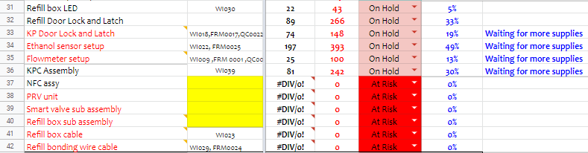
ON HOLD ITEMS/ AT RISK

Slide 6
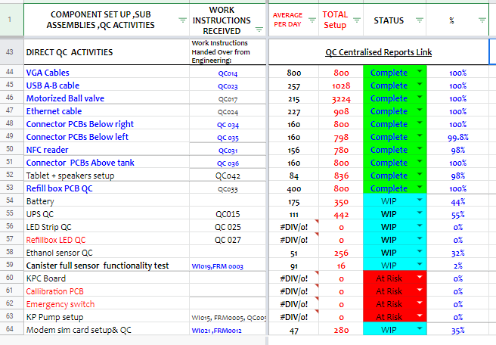
QC ACTIVITIES ON SUBASSEBLY FLOOR

Slide 7
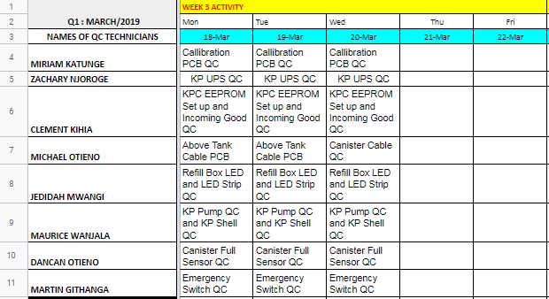
0

Slide 8
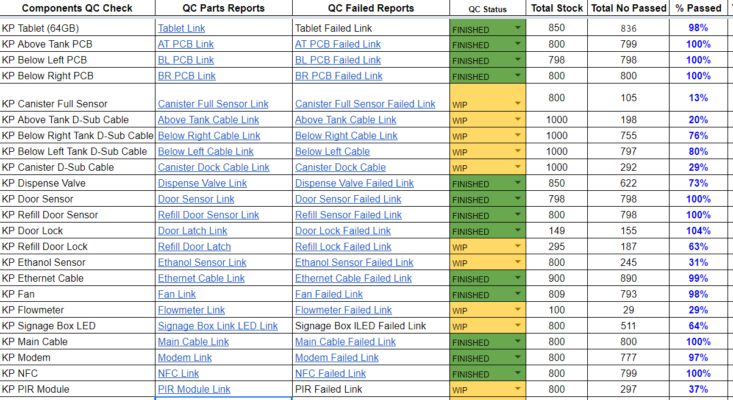
SUB-ASSEMBLY QC REPORTS

Slide 9
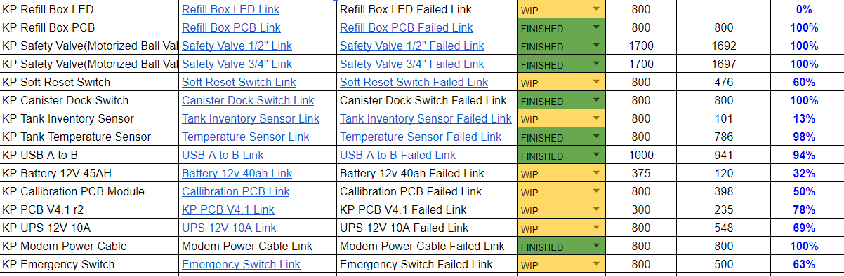
SUB-ASSEMBLY QC REPORTS

